Slide 1
Waste Classification Using CNNs
ECE/CS/ME 539 Introduction to Artificial Neural Networks
James Chen (UG), Leobardo Guardado Jr. (UG), Emilio Oliveros (UG), Joel Myers (UG)

Slide 2
Problem Description
Build a high‑accuracy 9‑class image classifier to automate waste sorting, enabling low‑cost real‑time recycling and reducing the 70–80 % of recyclables now lost to landfills.
Manual Sorting is slow & costly
High contamination rates
Current automated systems are limited
Data scarcity for vision-based solutions
Hassan Khoury ©

Slide 3
Dataset
Sourced from the UC Irvine Machine Learning Repository (RealWaste Paper)
Contains 4,752 color JPEG images with image resolution: 524 × 524 pixels
Captured at landfill reception points
Each image is labeled with the predominant material type:
Cardboard, Food Organics, Glass, Metal, Miscellaneous Trash, Paper, Plastic, Textile Trash, Vegetation
Images were resized and normalized, and splited into 80/20 train-test sets

Slide 4
Dataset Augmentation
Tested Transformations:
Best Performing Augmentation Pipeline:
Random Resized Crop
Horizontal Flip
Rotation
Color Jitter
Random Erasing
Random Perspective
Gaussian Blur
transform_train = transforms.Compose([
transforms.RandomResizedCrop(224, scale=(0.8, 1.0)),
transforms.RandomHorizontalFlip(),
transforms.RandomRotation(20),
transforms.ColorJitter(brightness=0.2, contrast=0.2, saturation=0.2, hue=0.1),
transforms.ToTensor(),
transforms.Normalize(mean=[0.485, 0.456, 0.406],
std=[0.229, 0.224, 0.225])
])

Slide 5
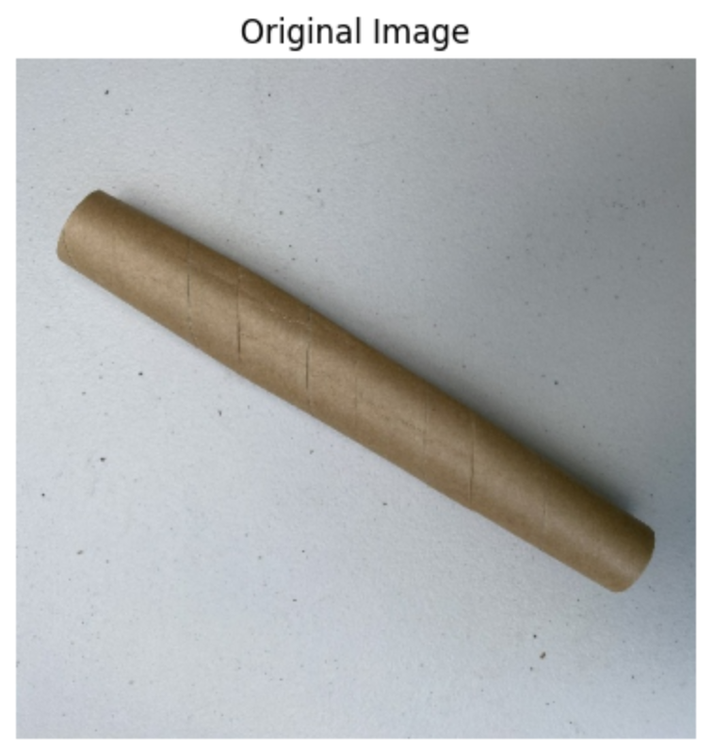
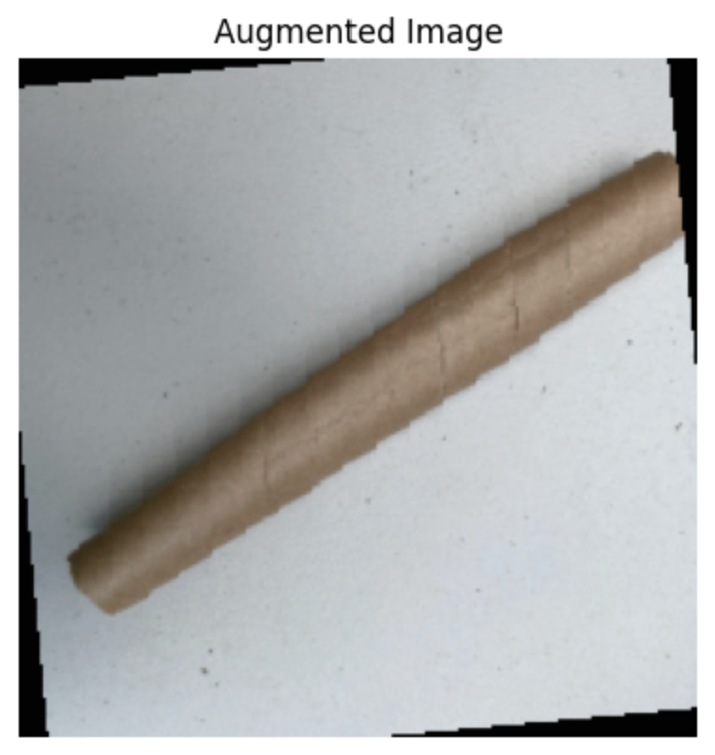
Augmentation Visualized

Slide 6
Related Work
Wang et al., “Intelligent & Sustainable Waste Classification Model” tackle class imbalance on TrashNet (database) with a light weight multi-branch network
Albashish et al., “AI-Powered Waste Classification Using CNNs” compare VGG-16 and ResNet-50, reaching 93% accuracy on TrashNet
Zafar et al., “Enhanced CNN Methodology for Solid-Waste Classification” fine-tune MobleNetV2/EfficientNet and report > 90% accuracy on mixed dataset

Slide 7
Methods
Training pipeline
Preprocessing/Augmentation-> Feature extraction training ->Fine-tuning -> Evaluation
Six pre-trained models are selected for architecture diversity
VCG-16: Shallow architecture
DenseNet121: Offer depth
Inception V3: Grouped layers
MobileNet V2: Lightweight design
Wide ResNet101_2: Enhanced capacity
ConvNeXt Base: Transformer-inspired elements

Slide 8
Methods
Feature extraction training
All model parameters were frozen except for the top classifier layer
8 or 10 epochs, LR: 0.01
Full fine-tuning
All layers were unfrozen
10 epochs, LR: 0.001 (prevent unstable oscillations)
SGD optimizer with a momentum of 0.9 and a weight decay of 0.0005
Accuracy, F1 score, precision, recall, and confusion matrix were reported for evaluation

Slide 9
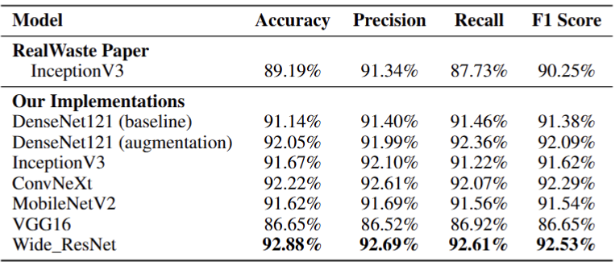
Results - Model Comparison

Slide 10
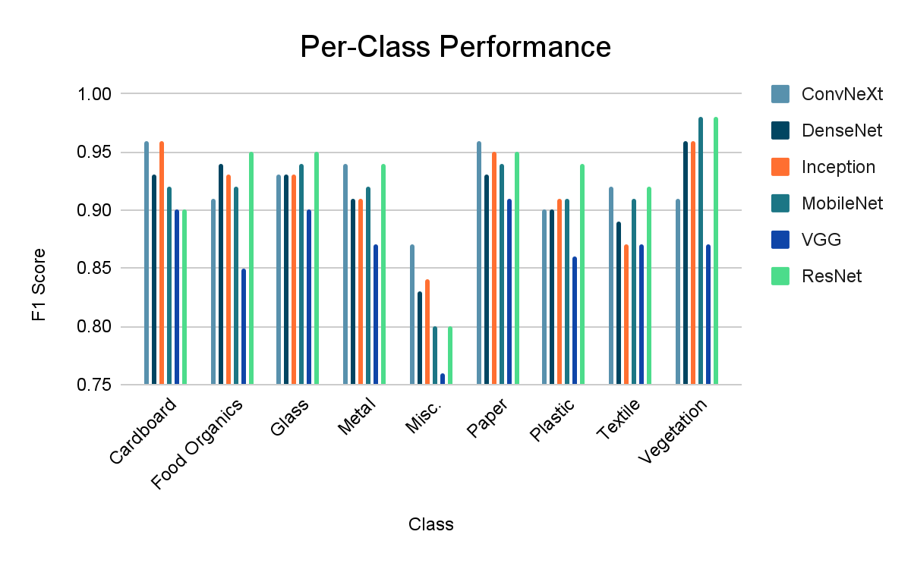
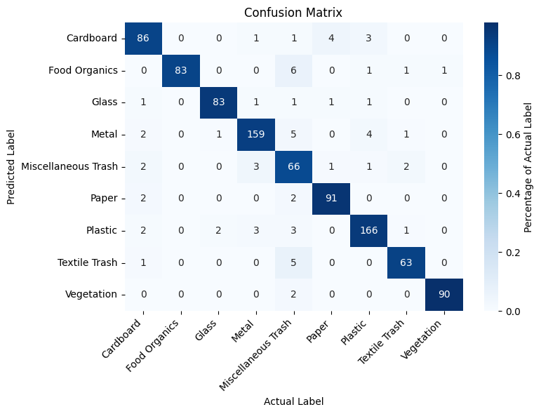
Results - Class Performance
Best Model (Wide ResNet)

Slide 11
Thank You!

